Slide 1
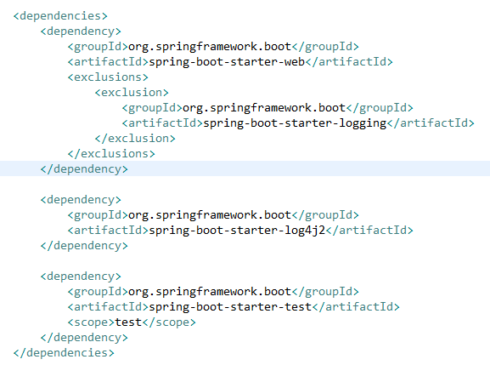
Spring boot log4j2 configuration example
Spring boot’s default logging uses Logback which is included as transitive dependency. Spring Boot supports Log4j2 for logging configuration if it is on the classpath.
To configure log4j2 , First remove spring’s default logging dependency and then add log4j2 dependency.

Slide 2
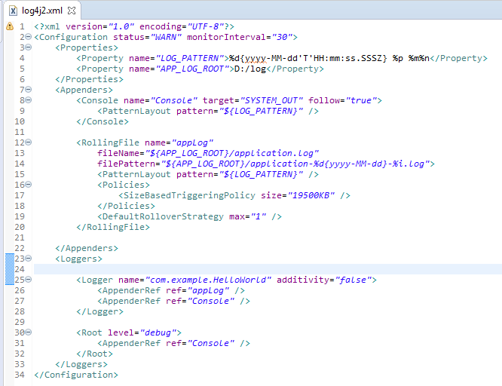
Spring boot log4j2 configuration example
Spring will automatically configure log4j2 once it finds it’s jar files in classpath. Now you have to add log4j2.xml or (log4j2.properties) in src/main/resources folder.

